Slide 1
General Budget Training
Susan L. Schady
Budget Director
Spring 2024

Slide 2
Topics
The Budget Office
Position Numbers & Funding
Using Banner to Check Budgets/Actuals
Transferring Budgeted Funds
The Basics of Fringe Rates
Budget Office Website on Citadel.edu

Slide 3
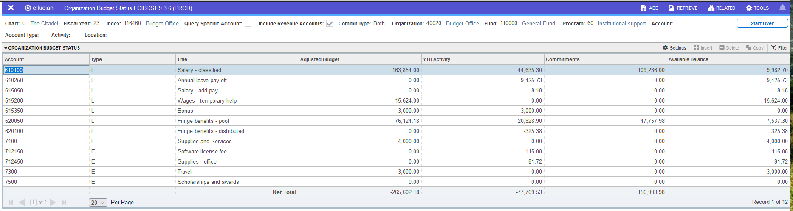
Where Does The Budget Office Fit In?
Budget Office
Adjusted Budget
Financial Services
YTD Activity
Procurement
Commitments

Slide 4
Position Numbers & Funding

Slide 5
Position Numbers & Funding
What is a Position Number? ​
Every job is assigned a six-digit position number: either a part-time position number or a full-time position number (FTE). ​
  Part-time positions start with letters, e.g. "HTXXXX"​
  Full-time positions are all numbers​
The position number tells us to which index and account to charge a person's job​
Only one person can be in a full-time position number​
Multiple people can be in a part-time position number

Slide 6
Requesting Temp Position Numbers
The Budget Office assigns position numbers for temporary positions: hourly temps (HT), salaried temps (ST), bonuses (BA), dual employment (DE), and graduate assistants (GA)
HR assigns permanent position numbers
Email Susan Schady with your request for a temporary position number
    IMPORTANT: Please provide the index to charge; the budget office does not have this information​
    Also indicate what type of position you need (HT, ST, etc.)

Slide 7
Temporary vs Full Time Position Numbers
Part time position numbers:
“HTXXXX”
HT - Hourly Temps
ST - Salaried Temps
TP – Temporary salary
BA - Bonus
DE - Dual Employment
GA - Graduate Assistants
CS - Cadets
Multiple people can fill a part time position
Budget office assigns temp position numbers
Full time (FTE) position numbers:
“001234”
Only one person can be in a full time position
HR assigns FTE position numbers

Slide 8
Funding Position Budgets
The Budget Office handles funding of ALL (temp and permanent) position budgets.
At the start of the fiscal year (July 1st) the position budget as of June 30th rolls to the new year to fund the labor accounts. Adding up all the position budgets assigned to a certain labor account (e.g., 610100 Salary Unclassified) gives you the total labor funding for that labor account.
When completing the EPAF if the current position funding is insufficient to cover the proposed salary you must explain where to get funds from.

Slide 9
Using Banner to Check Budgets/Actuals

Slide 10
Introduction to Indexes
To use Banner you need to understand “Indexes”
An index is a six-digit number that represents the combination of a:​
​
  Fund: which represents a pot of money (like Education & General or Targeted Fees) ​
  Organization: which tells who is using the pot (like Budget Office or Public Safety) ​
  Program: which tells why they are using the pot (like Institutional Support or Academic Support) ​
Fund + Organization + Program = FOP​
FOPs (represented by Indexes) group certain revenues and costs together so spending can be viewed in a more consolidated way ​

Slide 11
Introduction to Indexes
Index: 116460
Fund:
110000
Represents a pot of money
Example:
Education & General (E&G)
Targeted Fees
Organization:
40020
Who is using the pot
Example:
Budget Office
Public Safety
Program:
60
Why they are using the pot
Example:
Instructional support
Research
FOP

Slide 12
Introduction to Indexes
Many indexes share the same number as their funds, but in some cases the indexes roll up to another fund (such as E&G 110000)​
There are two main groups of indexes: ​
  Education & General (E&G) indexes that start with "11XXXX". ALL of these indexes are in Fund 110000 (all the E&G indexes share the same pot of money). They can all have different organizations and programs. E&G indexes are closely monitored. They are funded with tuition and state dollars and are only used for education and administration of education. ​
  Non E&G indexes: these indexes (12XXXX-99XXXX) will each have their own unique pot of money – Fund - which happens to be the same number as their index number. Each of these indexes must be "self-sufficient". This means you can only spend what you have on hand in cash in that index’s fund (while following the rules of the specific fund).

Slide 13
Introduction to Indexes
7100 – supplies & services
  711950 postage
  712000 printing
  712450 office supplies
  712600 telephone
7300 - travel
7400 - utilities
7600 - equipment
7800 - recoveries
Account Pool
Account
Note:
In the operating budgets we budget to the “4-digit Account Pool”
We charge actuals to the “6-digit Account”

Slide 14
Introduction to Indexes
Your group will be responsible for the budgets and spending in certain indexes and you should make sure you have a complete list of those indexes​
If you need help figuring out which indexes are "yours" please contact the Budget Office

Slide 15
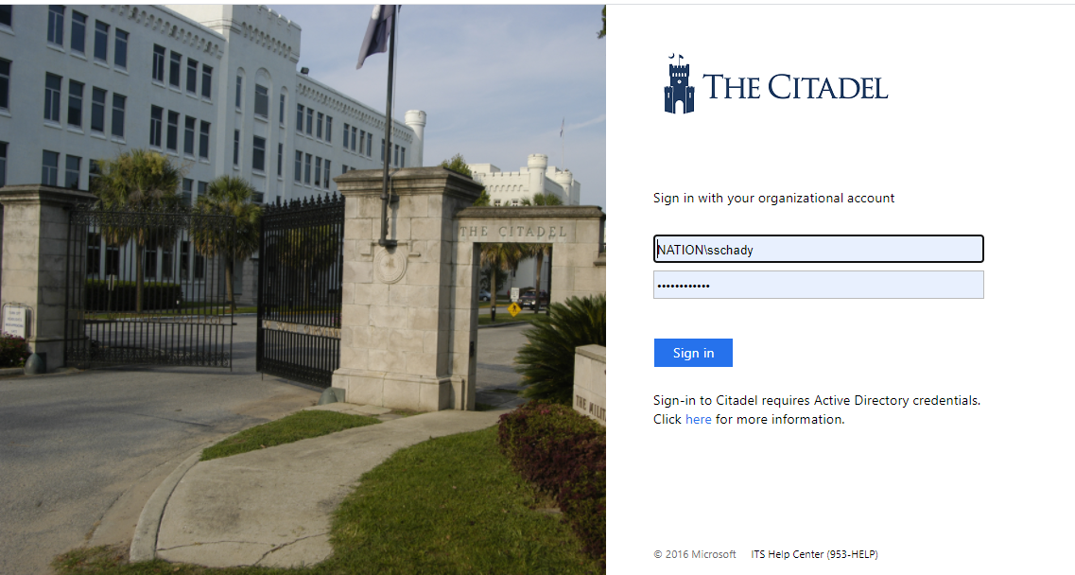
Access Banner: Step 1 (Login to Lesesne Gateway)
Your Citadel Username and Password

Slide 16
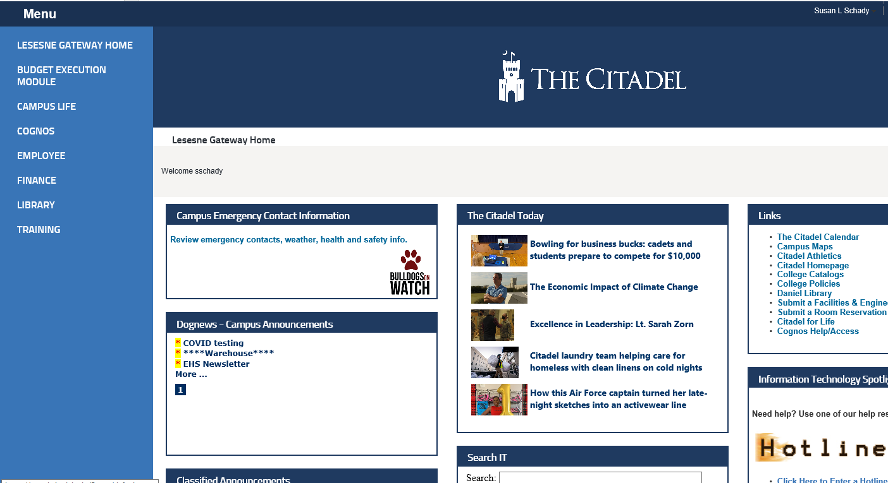
Access Banner: Step 2
Hover over “Menu”
Select Finance Tab

Slide 17
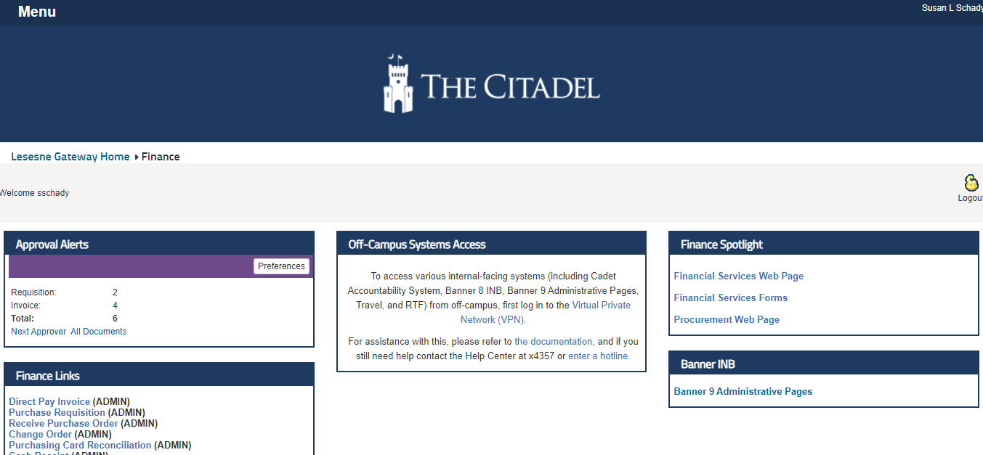
Access Banner: Step 3
Select Banner 9 Admin Pages
11-15-2018
Budget Office
17

Slide 18
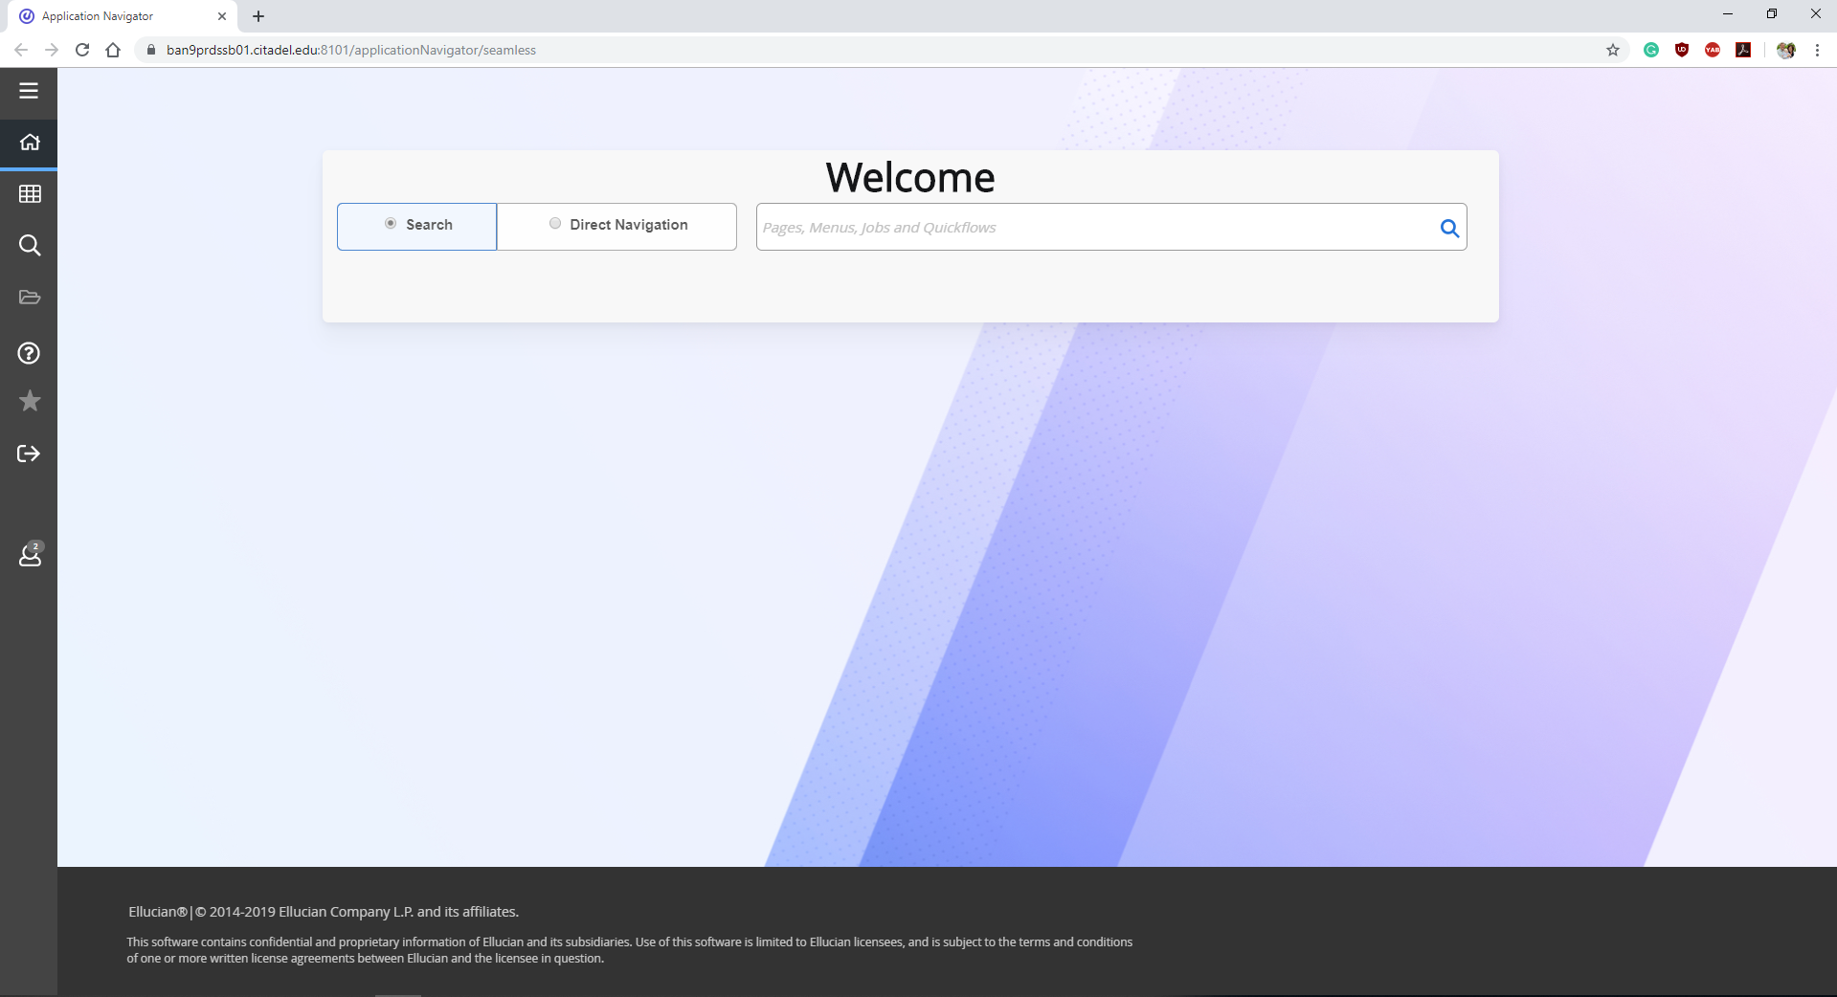
Banner Main Screen
Menu Toggle
Applications:
Banner
My Banner
Banner Self Service

Slide 19
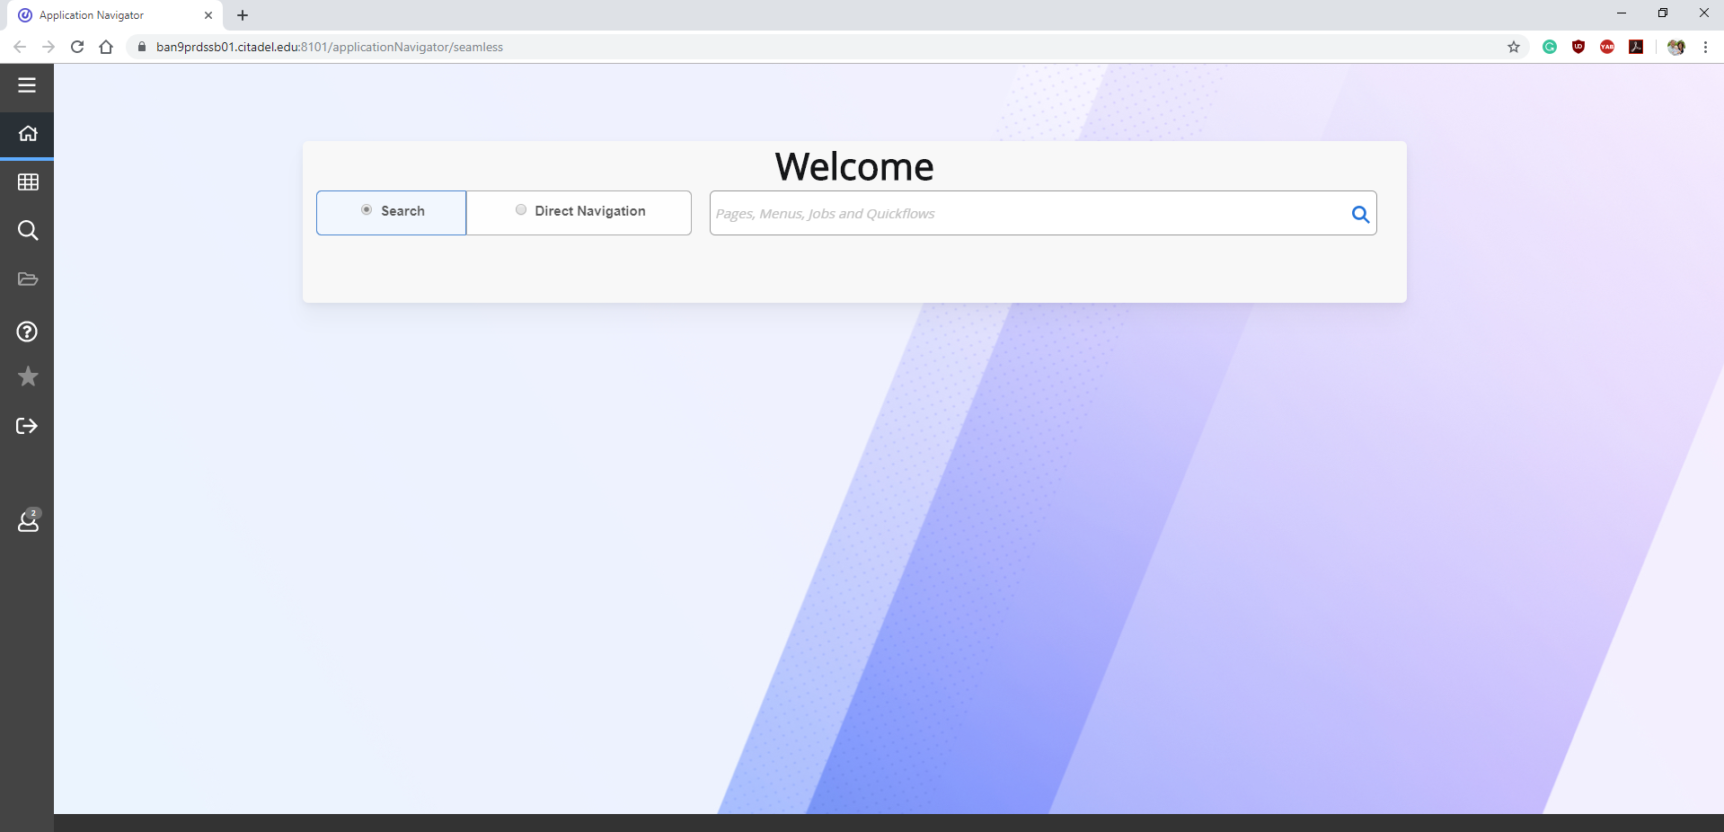
FGIBAVL: Available Budget
Enter abbreviation into the “Search” bar and
hit Enter on keyboard
(FGIBAVL)
(BAVL)

Slide 20
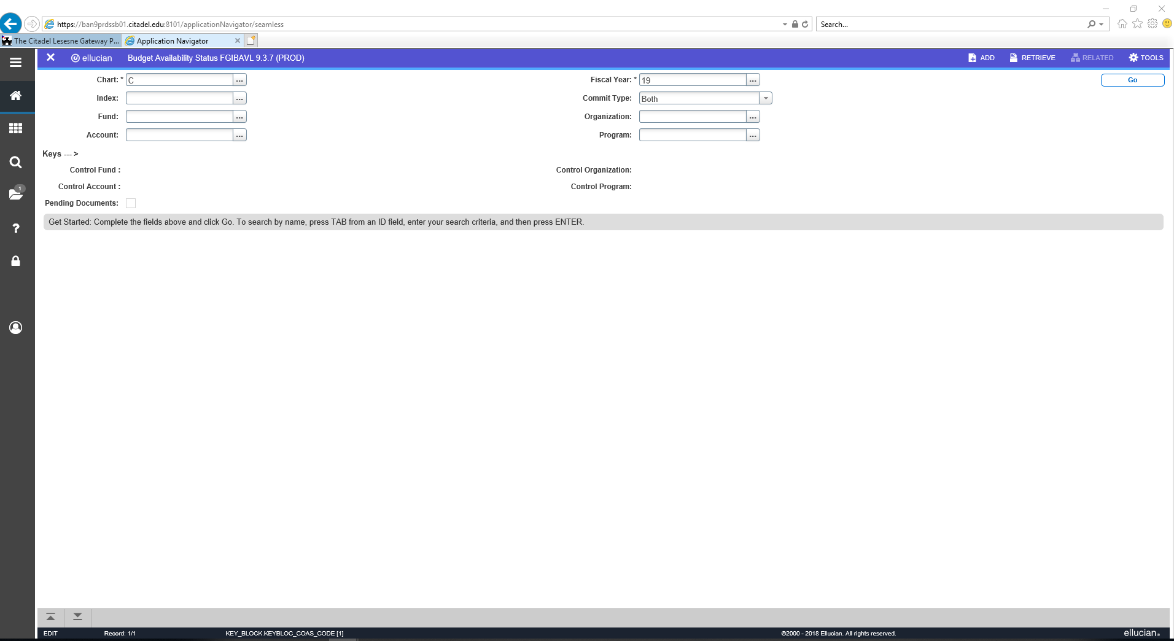
FGIBAVL: Available Budget
4) Select “GO”
3) Enter fiscal year
Enter a 6-digit Index
The fund, organization, and program codes will populate, and……You can also use the ellipsis as a search.
2) Enter a 4-digit account pool you want to view. (Important note: the pool you enter will appear plus all pools above. Ex: If 6100 is entered, all pools 6100 and above will appear)
Don’t forget to enter the Account Pool when using BAVL

Slide 21
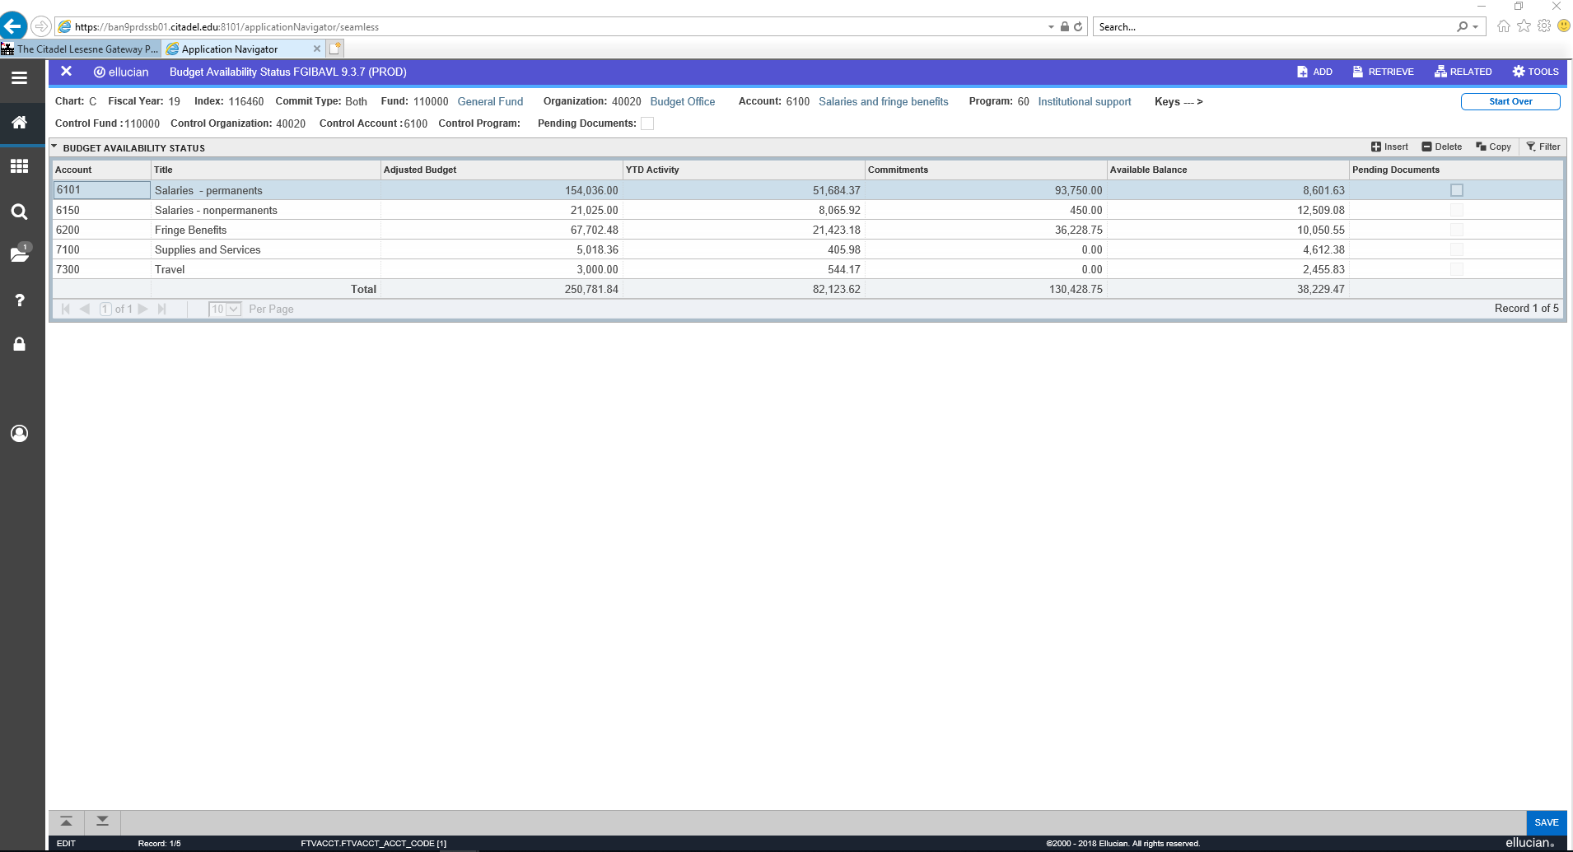
FGIBAVL: Available Budget
FGIBAVL:
1) Shows expense only, NOT revenue
2) Summarizes by account pools
3) Shows total available balance
4) Identifies where surpluses & deficits are developing by pool
5) Recommend ONLY USE FOR “11” INDEXES (E&G)

Slide 22
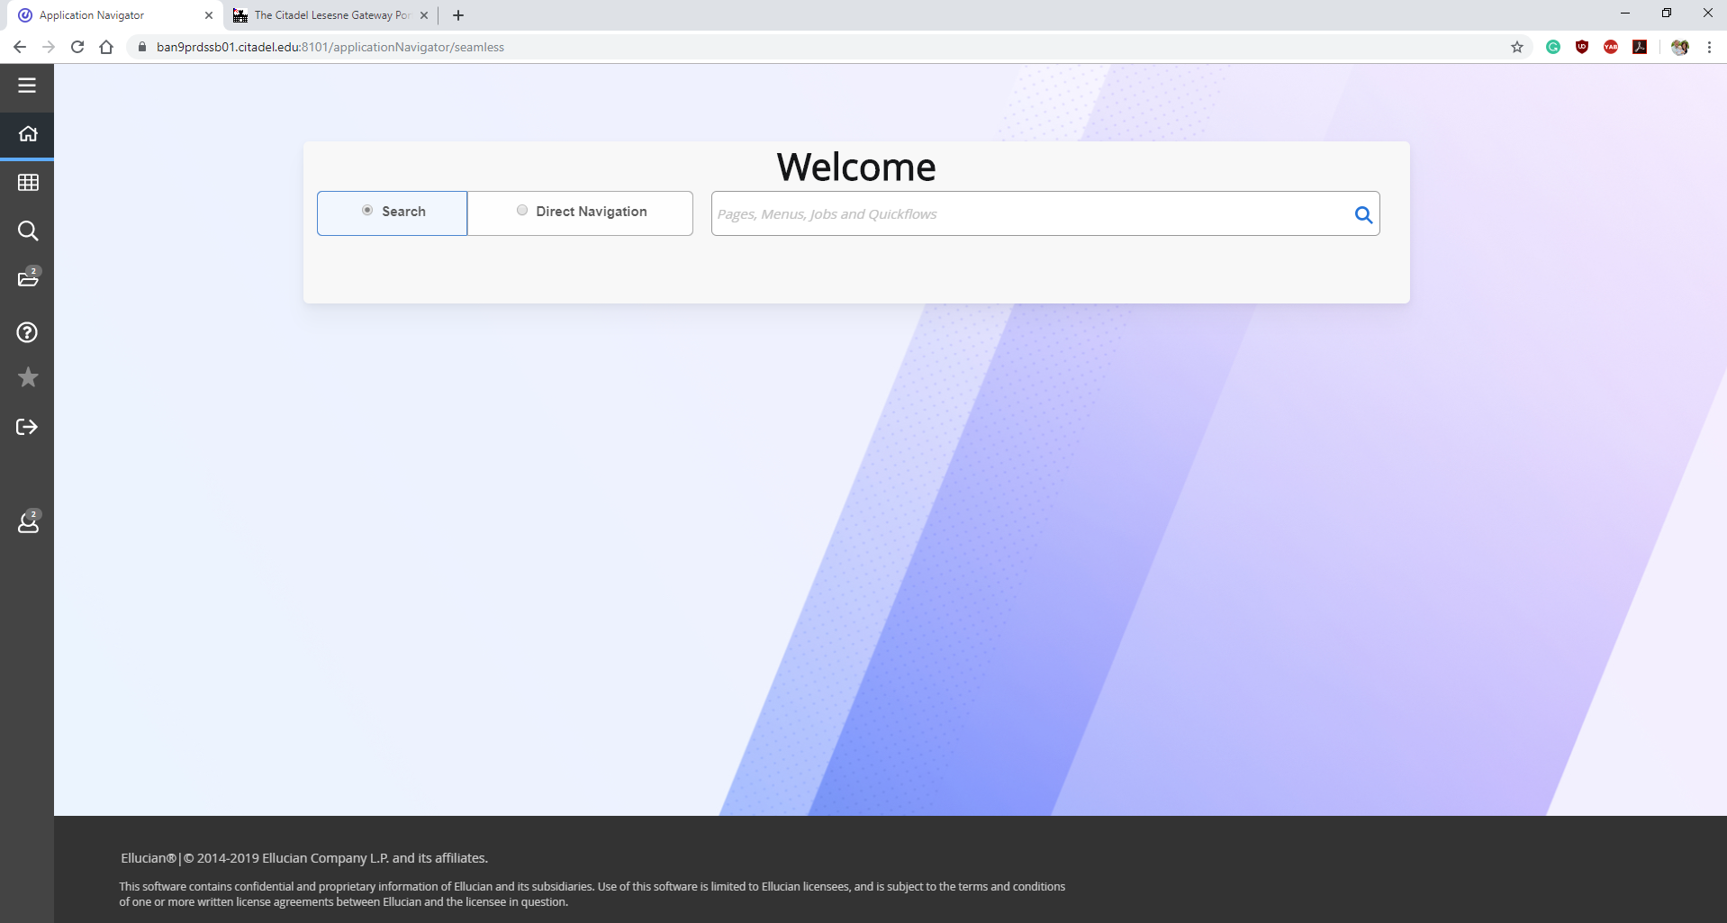
FGIBDST: Budget Distributed (Budget Status)
Enter abbreviation into the “Search” bar and
hit Enter on keyboard
(FGIBDST)
(BDST)

Slide 23
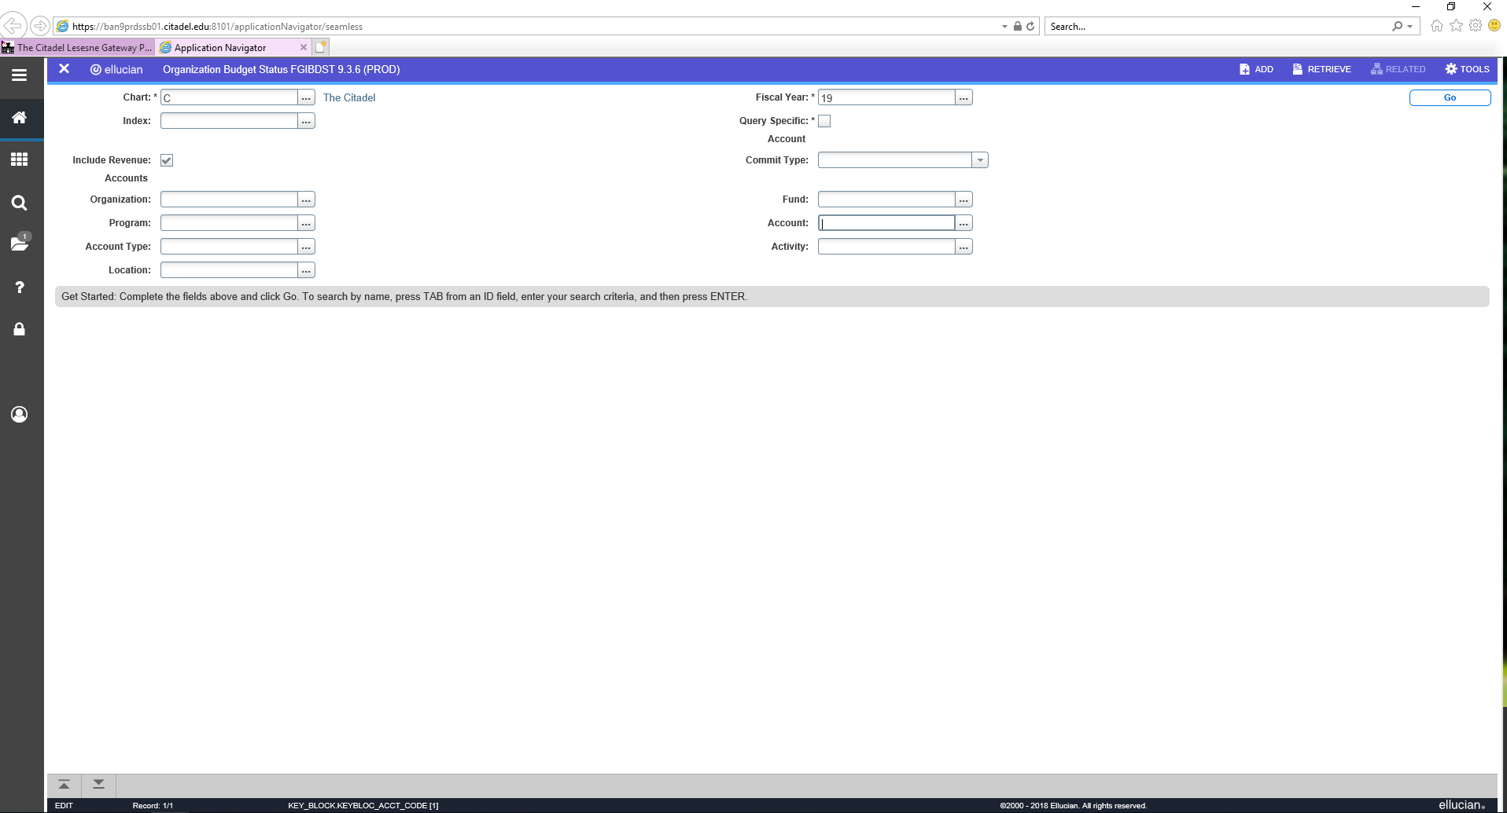
FGIBDST: Budget Distributed (Budget Status)
Enter a fiscal year
GO
Enter a 6-digit Index.
You DO NOT need to enter the Pool (e.g., 6100)
You can also use the ellipsis to search for an index

Slide 24
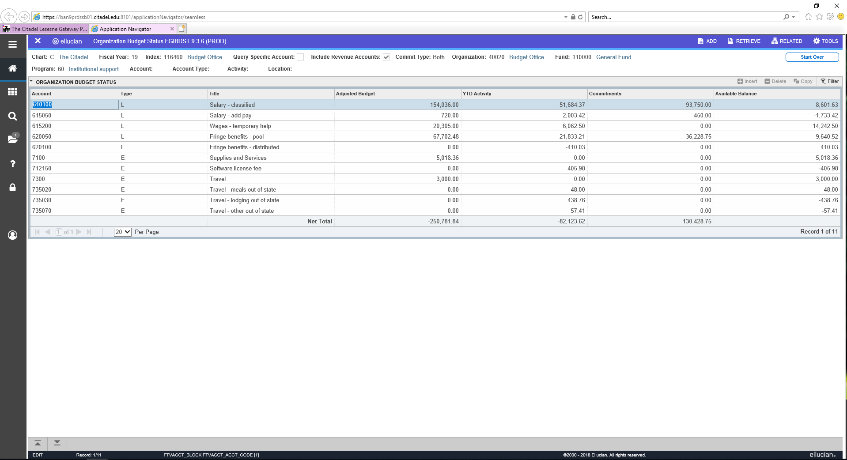
FGIBDST: Budget Distributed (Budget Status)
FGIBDST:
Shows detail by account and pool
Shows revenue and expense
Individual balances are shown
Does not show total available balance
Exportable to Excel
Positives are surpluses, negatives are deficits relative to the budget

Slide 25
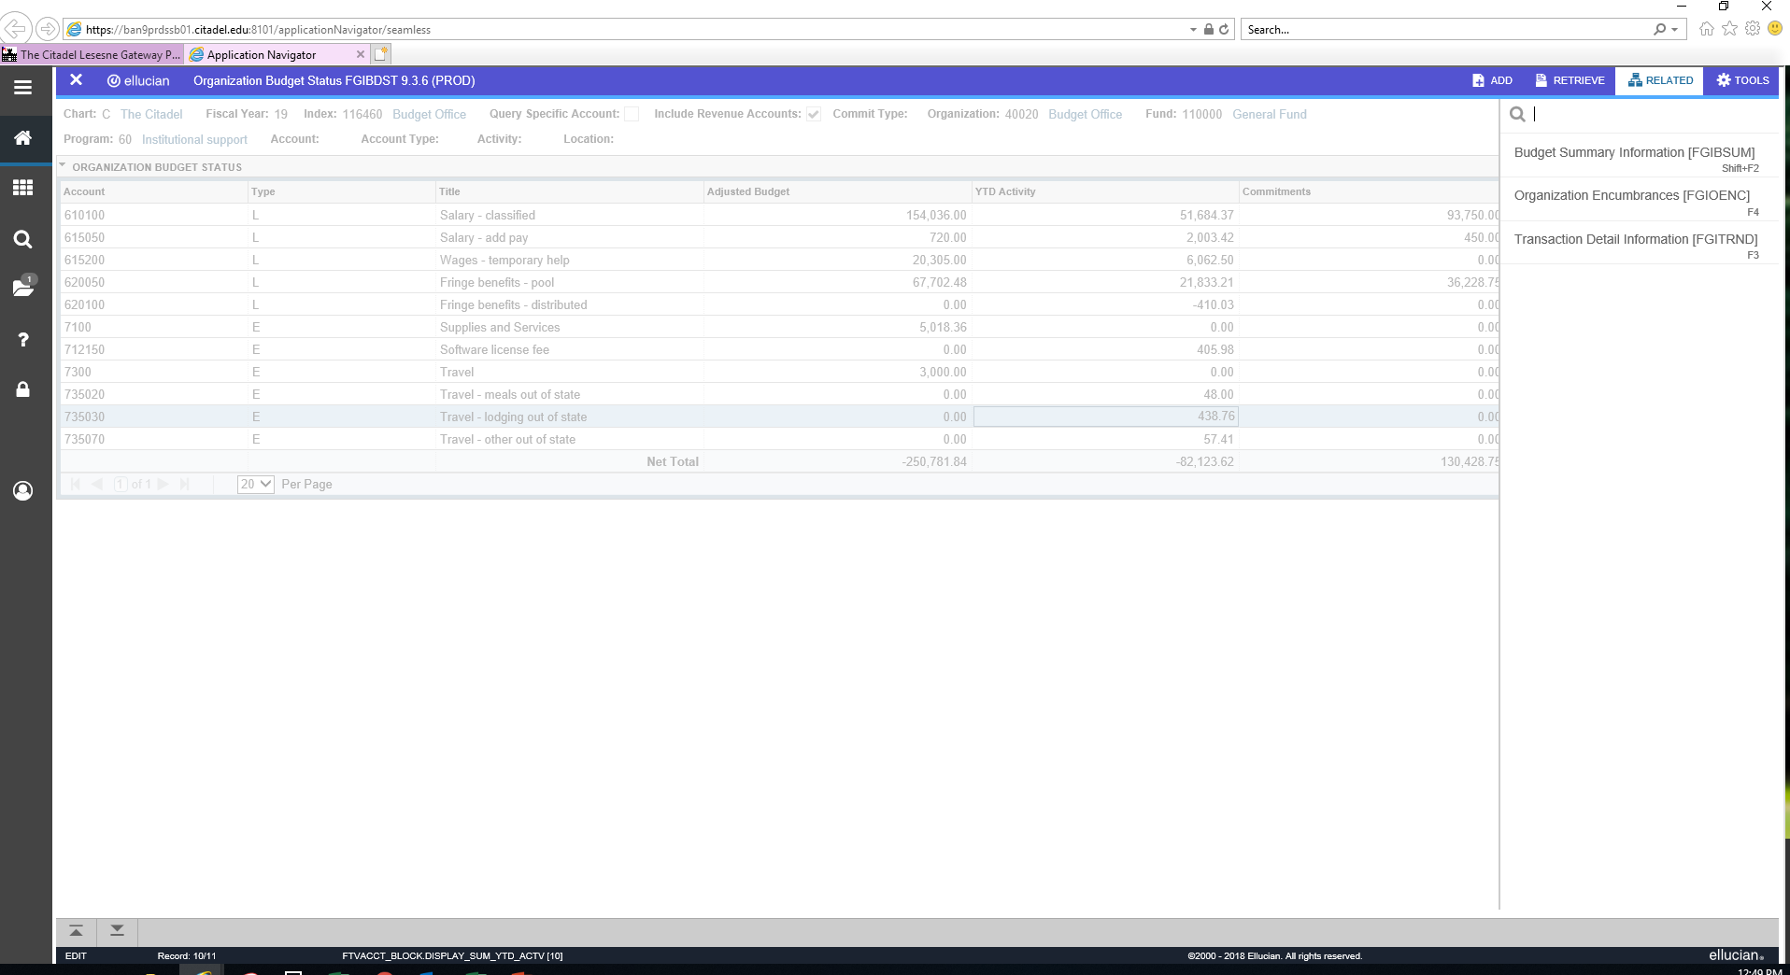

FGIBDST: Budget Drill Down
1) Place cursor in the field
you would like to drill-
down into.
2) Select “RELATED”
3) Select “Transaction Detail
information”

Slide 26
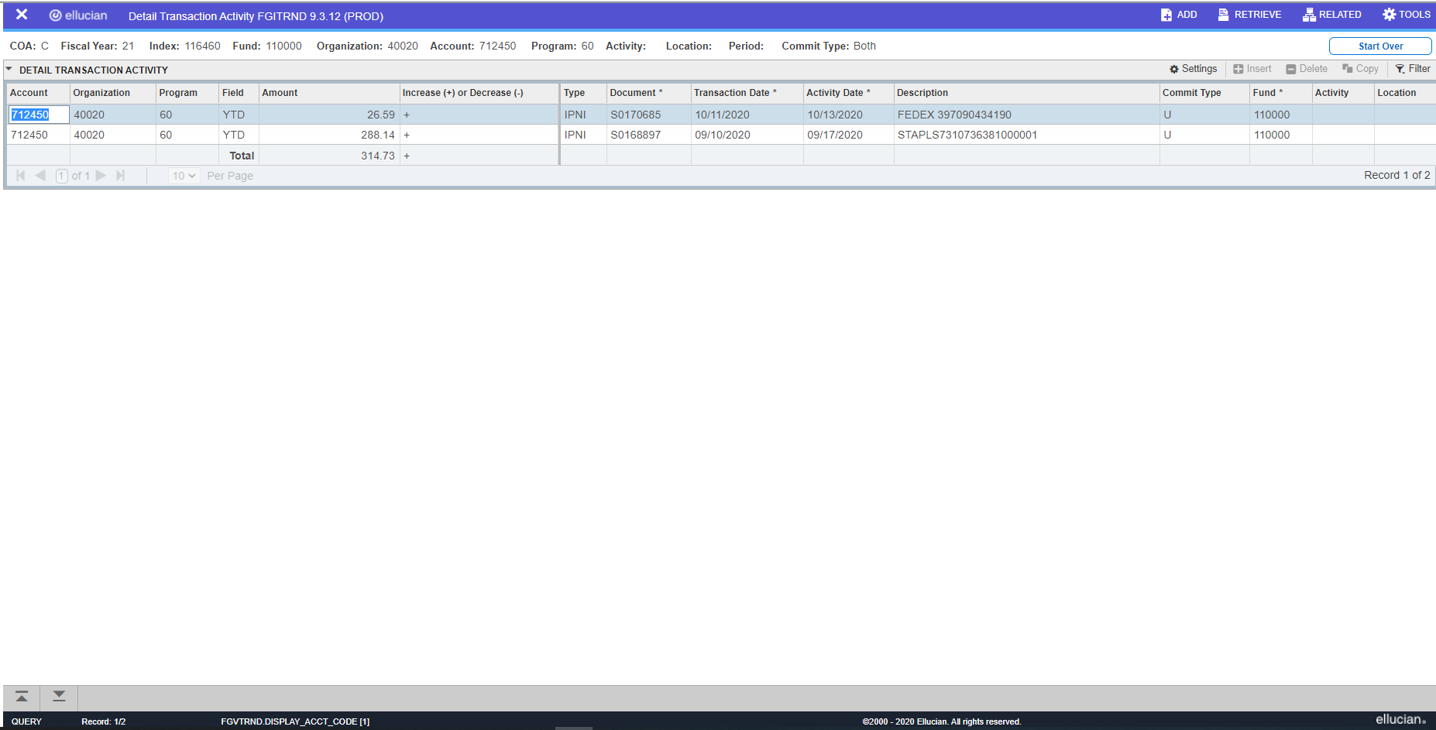
FGIBDST: Budget Drill Down
You will be brought to a screen that shows each transaction to hit that account and a brief description
The first letter of the Document number gives you an idea about where the charge came from. “S” means a P Card, “I” is an invoice through procurement, “UP” is a direct upload to the system

Slide 27
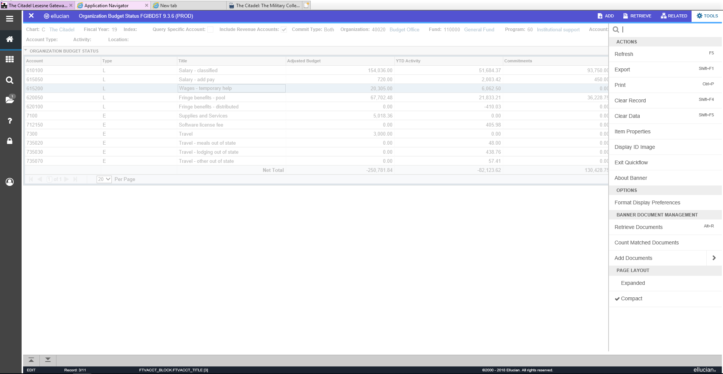
Export A Report to Excel
Select “TOOLS”
Select “Export”

Slide 28
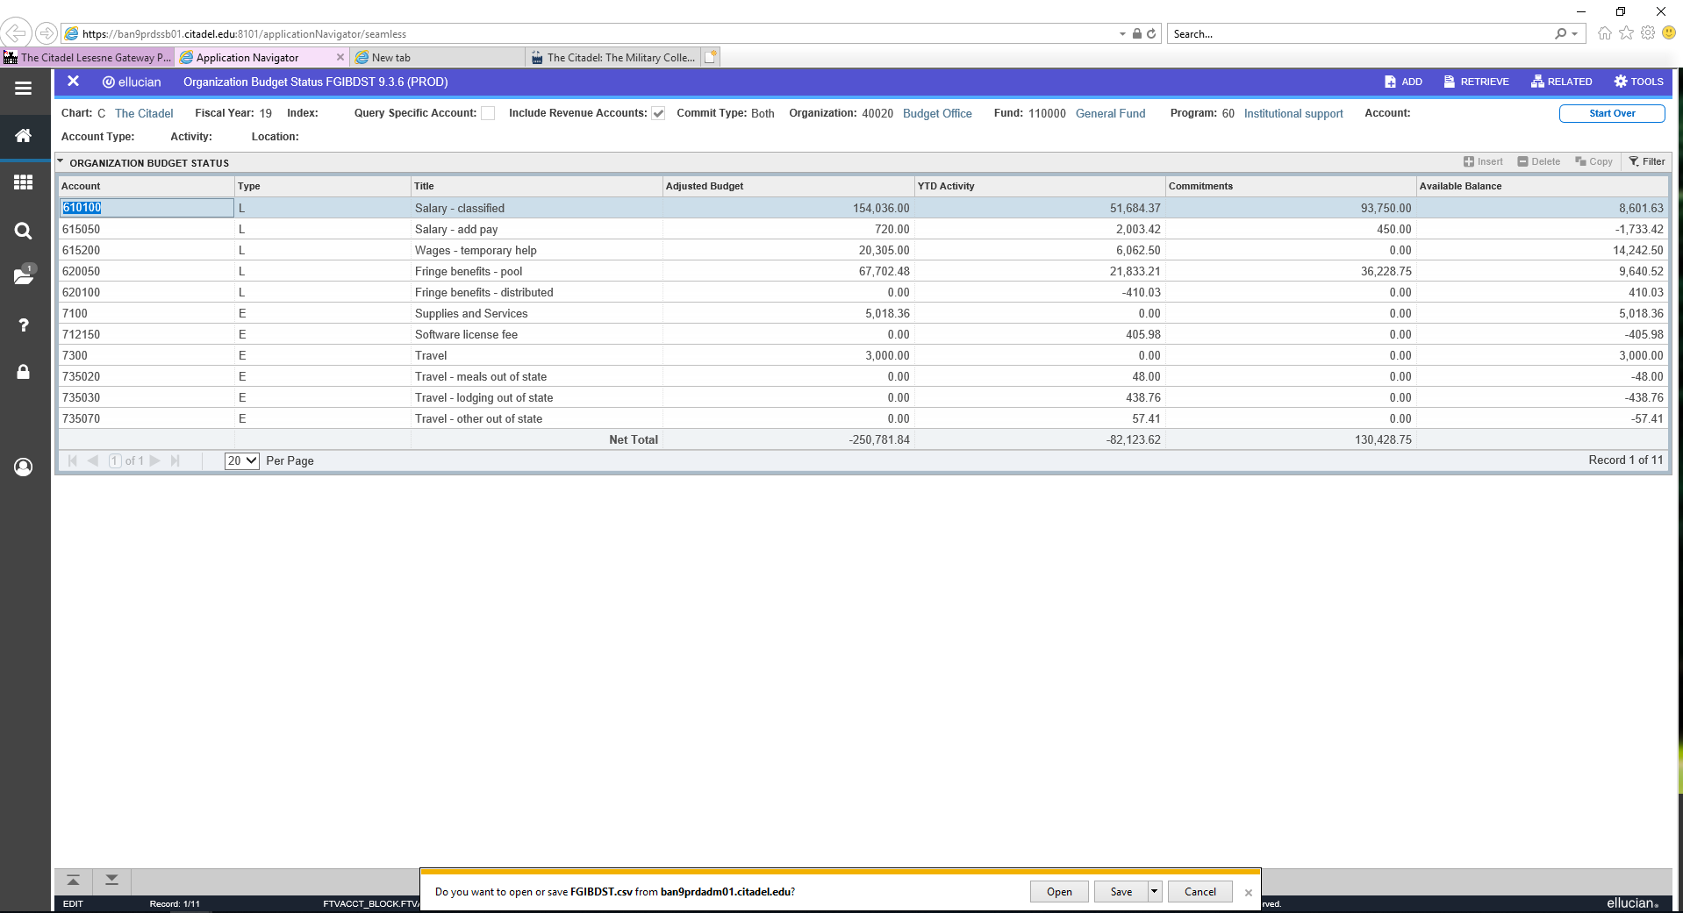
Export A Report to Excel
A pop-up menu will appear at the bottom Select “Open”

Slide 29
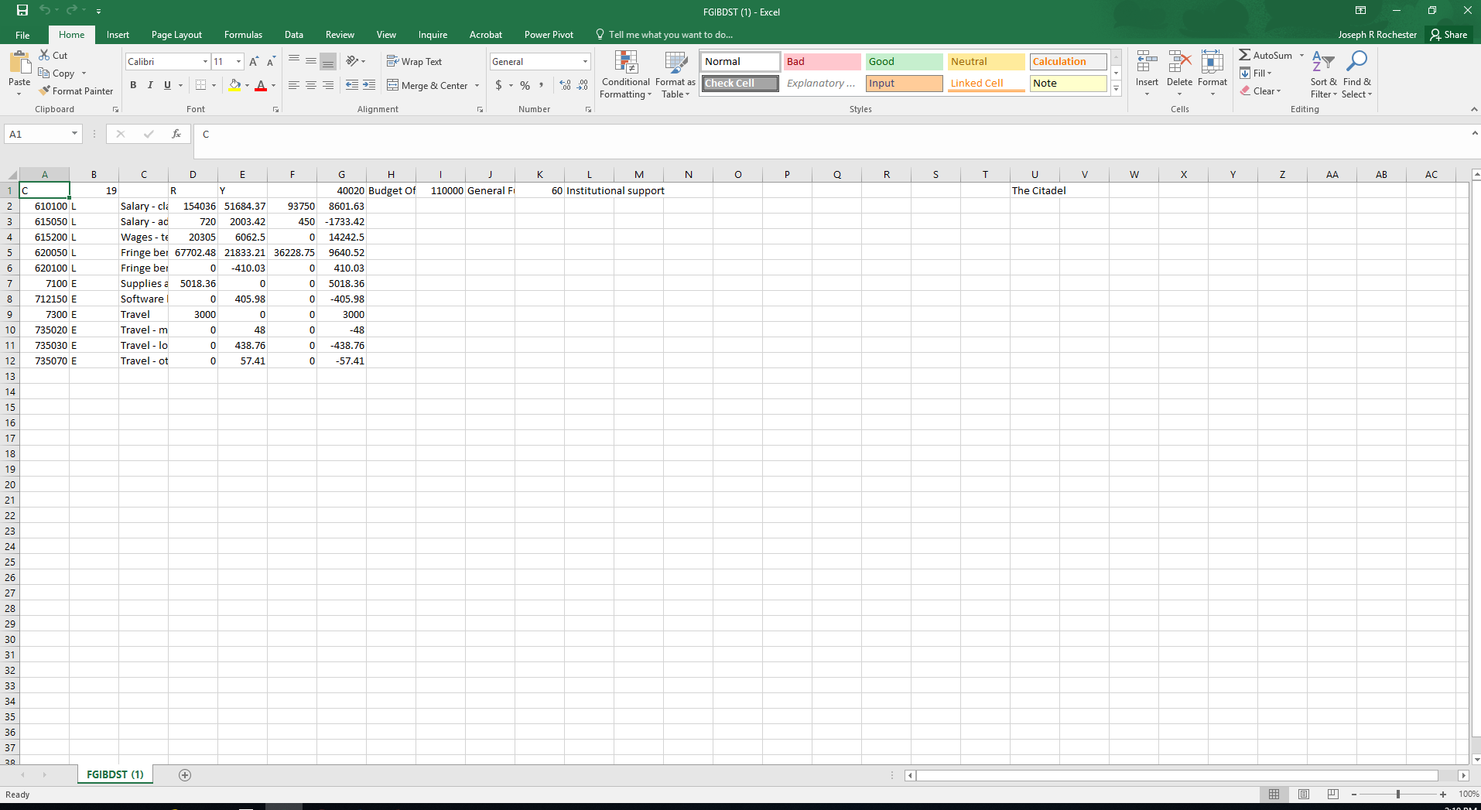
Export A Report to Excel
Tip: if you are working on an analysis, be sure to immediately “save as” an Excel-type file to avoid any loss to your work
You don’t want to work with a CSV file
Excel will open a spreadsheet with the data

Slide 30
Fund Cash Balance
For Non E&G indexes/funds you may want to check how much cash you have on hand
Remember, BDST shows your spending for a certain year (and budget for the year if you have created one) not your actual pot of cash on hand, you may have cash left over from last year
We do load your fiscal year starting fund balance information as a “cash carryforward” budget line item that you can see in BDST in late September
But at any time you can view your cash balance by going the “FGITBSR” screen

Slide 31
FGITBSR: Fund Cash Balance
Enter abbreviation into the “Search” bar and
hit Enter on keyboard
(FGITBSR)
(BSR)

Slide 32
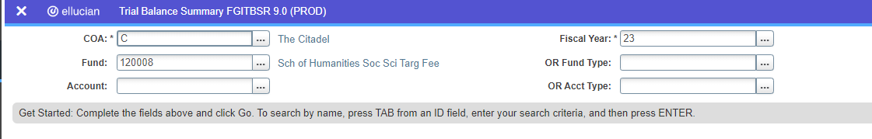
FGITBSR: Fund Cash Balance
Enter the fiscal year
Enter the fund (the same as the index for Non E&G)

Slide 33
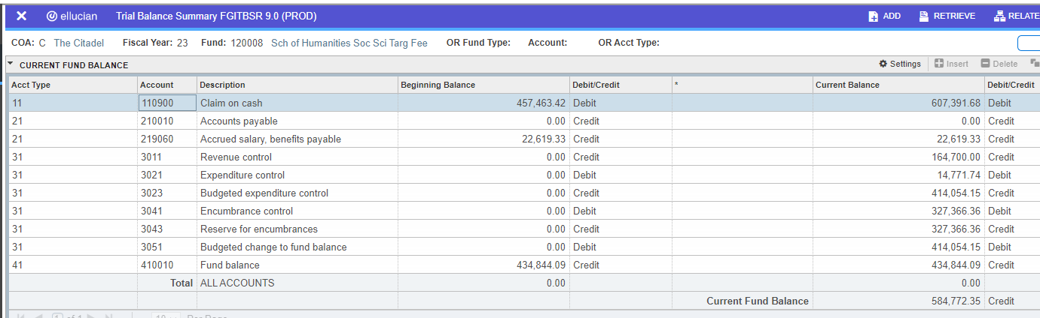
FGITBSR: Fund Cash Balance
Look at the “ Current Fund Balance” line in the “Current Balance” column
Note: “Credit” is positive, “Debit” is negative You don’t want to be negative!

Slide 34
FGITBSR: Fund Cash Balance
Note that the BSR screen does not account for encumbrances or “promised” funds from TCF or the Investment Pool/Scholarship book.
It is only a picture of how much cash you have at that exact moment in time, not necessarily what you have left to spend
So…..

Slide 35
How To Check What Is Left to Spend in a Fund
Go to the BDST Screen
Add together ONLY the following revenue budgets from “Adjusted Budget” column (if they exist) *because these revenue items will not have a corresponding YTD Activity entry:
  CCFWD Budget
  TCF Grant/Endowment/Rollover Budget
  Trust Scholarship Book/Investment Activity
Add/subtract total at bottom of “YTD Activity” column
Subtract total at bottom of “Commitments” column

Slide 36
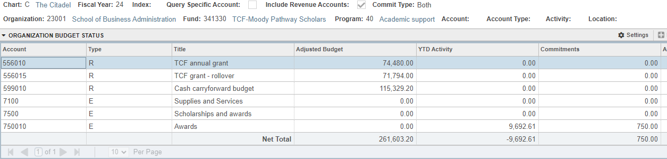
How To Check What Is Left to Spend in Index Cont.
1
2
1
2
3
3
261,603.20 - 9,692.61 - 750 = $251,160.59 Left to Spend

Slide 37
Transferring Budgets

Slide 38
Transferring E&G Operating Funds
Organizations can use Banner Self Service to transfer operating funds without approval between certain pools within the SAME index: 7100, 7200, 7400, 7500, 7600, etc.
Currently, organizations need permission from their VP/Provost to transfer funds between Travel (7300) and any other pool in an E&G index (per the Budget Guidance Memo). If approval is granted, please contact the Budget Office to have the transfer made.
Transfer of budgets between different E&G indexes (indexes that start with “11”) is not usually allowed and should not be done in Banner Self Service.

Slide 39
Transferring Non-E&G Operating Funds
Organizations can use Banner Self Service to transfer budgets within the same Non-E&G index (for example a gift fund). They are also allowed to transfer into and out of Travel (7300) without approval.
Organizations are also allowed to transfer cash between certain different Non E&G indexes. The organization must ask Financial Services to transfer the actual funds.
Please do NOT use Banner Self Service to transfer budgets between different Non-E&G indexes.

Slide 40
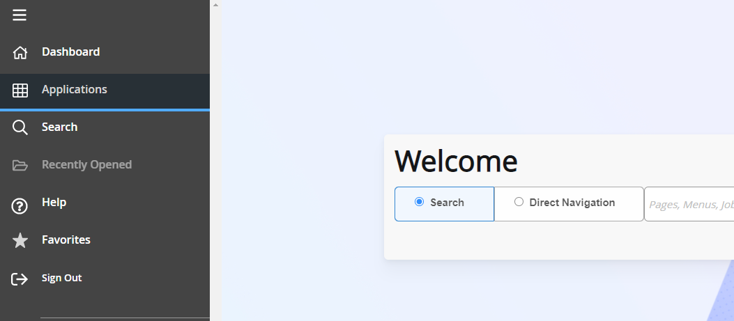
Using Self Service to Transfer Funds
Click “Applications”

Slide 41
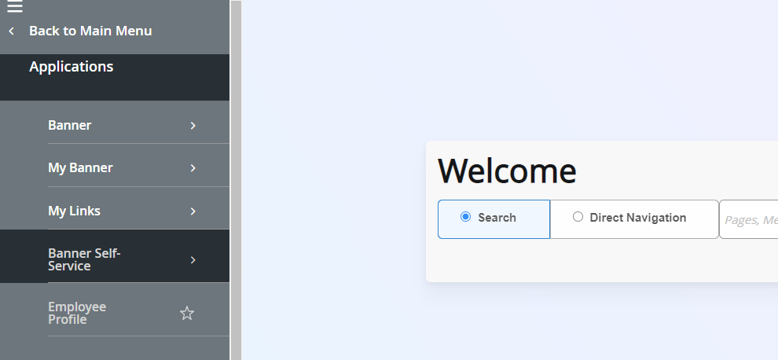
Using Self Service to Transfer Funds
Click “Banner Self Service”

Slide 42
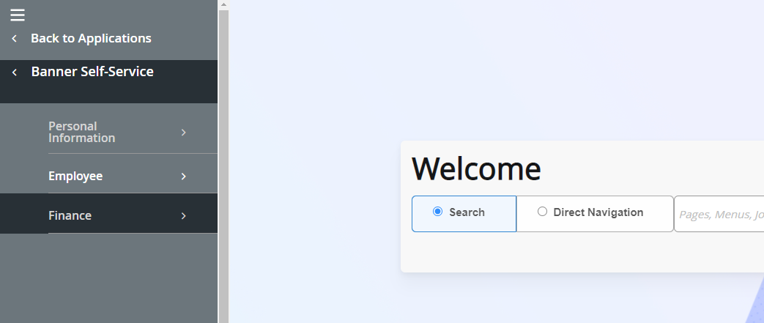
Using Self Service to Transfer Funds
Click “Finance”

Slide 43
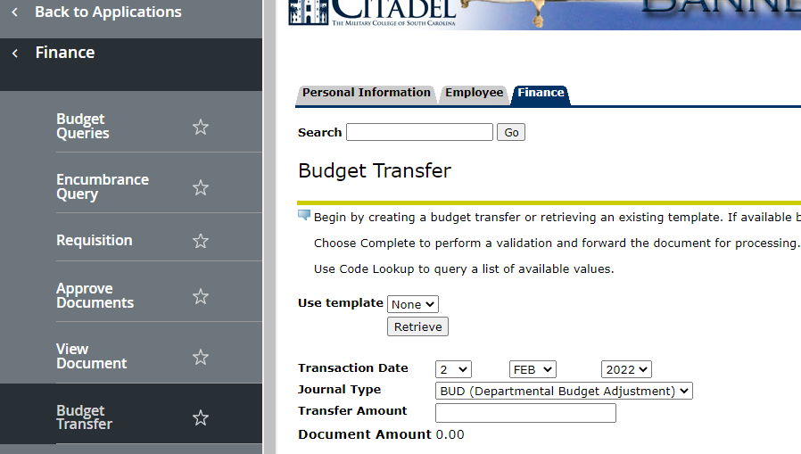
Using Self Service to Transfer Funds
Click “Budget Transfer”

Slide 44
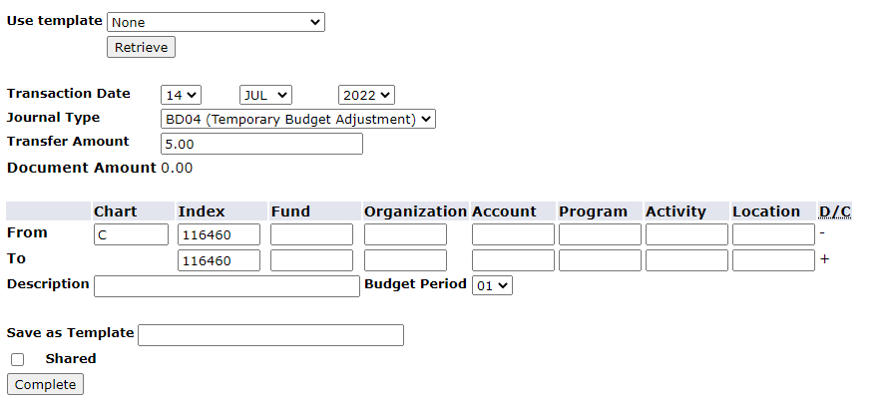
Using Self Service to Transfer Funds
System will default to current date, “BD04”, and budget period 01
Fill in amount to transfer
Fill in “C” for Chart
Fill in the From/To Index and click “Complete” (must be same index)

Slide 45
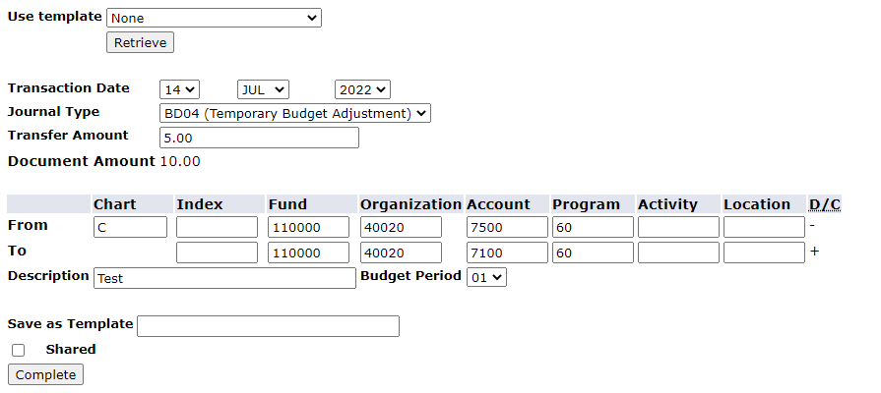
Using Self Service to Transfer Funds
System will then fill in Fund, Org and Program.
Fill in the accounts to transfer between
Fill in a description
Click Complete

Slide 46
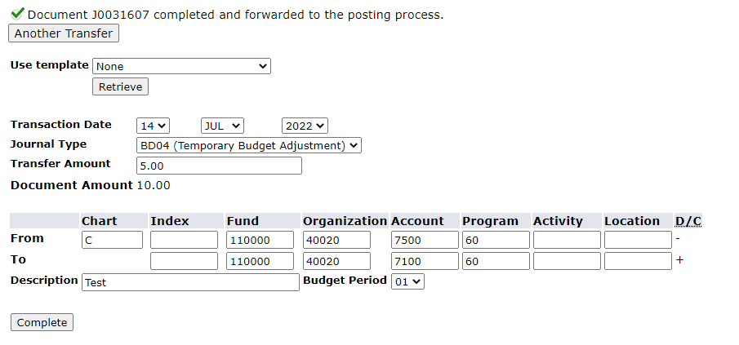
Using Self Service to Transfer Funds
If you see this you have been successful. Check BDST to confirm.

Slide 47
The Basics of Fringe Rates

Slide 48
Current Fringe Process
Fringe Budgets and YTD Activity in an index are BOTH set by using 26 fringe rates (based on Employee Class) – multiplied by budgeted/actual salaries​
This process does not consider actual fringe paid out – only what is estimated based on the fringe rates. No actual fringe numbers are booked to the various indexes

Slide 49
Current Fringe Process
Actual fringe numbers are all booked to index 116000 (Central Administration)​
Therefore, the Budget Office manually reconciles and redistributes what is booked to 116000 to each index every two weeks​
Reconciliation/redistribution in indexes is represented in account 620100 “fringe benefits – distributed”

Slide 50
How Fringe Rates Are Created
Employees are grouped into 26 "Employee Classes" ​
Examples include:​
    S2: Student Temporary (CS position numbers)​
    T2: Salaried Temporary (ST, TP, DH position numbers)​
    FA: Adjunct Faculty (AF position numbers)​
    N1: Classified Staff 12 Months Non-Exempt (FTE position numbers)​
    E1: Classified Staff 12 Months Exempt (FTE position numbers)

Slide 51
How Fringe Rates Are Created
Each payroll, the budget office tracks the amount of fringe actually paid out as a percentage of salary, grouped by employee class​
Taking an average over the fiscal year of each of these calculations produces an average actual fringe rate per employee class​
This is then compared to the previous year's rate and adjustments are made for the next fiscal year​
Lastly, the Budget Office then accounts for known increases or decreases (health insurance, pension) ​

Slide 52
Budget Office Website on Citadel.edu

Slide 53
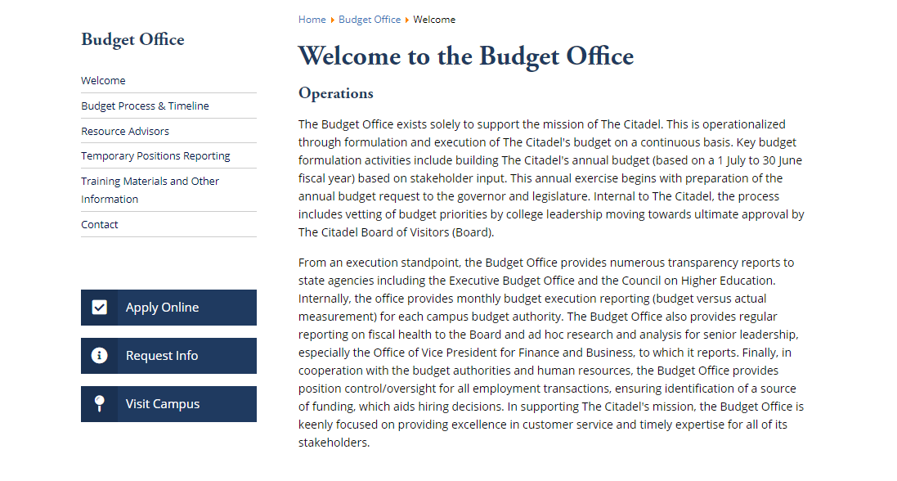
Budget Office Website: www.citadel.edu/root/budget
Budget Guidance Memo
List of Resource Advisors

Slide 54
Additional Resources
Summary of funds spent on temporary positions
Copy of this presentation & fringe rates

Slide 55
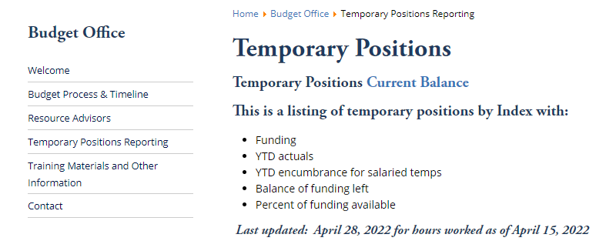
Temporary Positions Reporting
Click on “Current Balance”

Slide 56
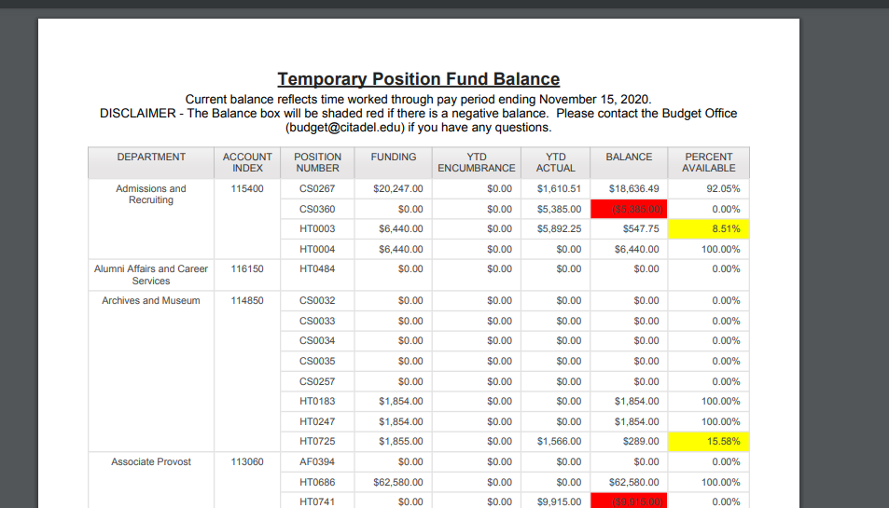
Temporary Positions Reporting
Produces a PDF listing all temp positions by index
Note: temp pay lags by 2 weeks

Slide 57
Questions?
Contact: Budget@Citadel.edu

