Slide 1
Advising & Retention Council
Spring 2025 Steering Committee Meeting

Slide 2

Agenda
Updates from Co-Chairs (COL John Robinson & Dr. Susan Wright)
Advising Facilitators (LTC Stephanie Fye)
Advising Assessment Updates (Dr. Stephanie Laughton)
Advising Resources Updates (Dr. John Egan)
Advising Syllabus Updates (Dr. Simon Ghanat)
Advising Summit Updates (LTC Stephanie Fye)
Student Health & Wellbeing Conference (LTC Stephanie Fye)
Open the floor for discussion (All)

Slide 3
ARC Purpose & Goals
Purpose
  Oversee the implementation of the QEP (“Advising Tomorrow’s Principled Leaders”) and other campus wide, strategic initiatives designed to maximize retention, persistence, and graduation rates for all cadets and students.
  Strengthen communication, collaboration, and coordination among student support services college-wide.
Goals
  Provide expert guidance on the development and implementation of the QEP and retention, persistence, and graduation rate initiatives for all cadets and students.
  Contribute to the creation of a comprehensive advising framework that aligns with institutional goals and all students’ needs.
  Collaborate with faculty, staff, and students to ensure the effectiveness of retention, persistence, and graduation rate initiatives.
  Recommend evidence-based strategies for improving retention, persistence, and graduation rates.

Slide 4
ARC Administrative Structure
BG Sally Selden, Ph.D., SPHR
Co-Chairs: COL John Robinson & Dr. Susan Wright
Coordinators: LTC Stephanie Fye & Dr. Karin Roof
Advising Resources Dr. John Egan | Advising Syllabus Dr. Simon Ghanat
Advising Assessment Dr. Stephanie Laughton | Advising Summit LTC Stephanie Fye

Slide 5
Advising Facilitators
Tommy & Victoria Baker School of Business
Morgan Mann
Undergraduate Program Coordinator & Academic Advisor
School of Engineering
Abby Giordano
Program Coordinator
School of Humanities & Social Sciences
Coletta Bethea
Program Coordinator
Swain Family School of Science & Mathematics
Ashley Bukay
Assistant Professor of Nursing
Zucker Family School of Education
Steph Eldridge
Director of Clinical Practices & Partnerships
Play a pivotal role in enhancing the advising experience for students and advisors at The Citadel
Coordinates efforts within the school, fostering communication and collaboration
Serve as the school’s advising expert and key communicator
Decrease transactional advising and increase developmental outcomes

Slide 6
Advising Assessment - General
Task: Collect, analyze, and present data to assess changes in student retention and experience due to implementation of new advising policies and practices via QEP
Membership:
  Dr. Stephanie Laughton – Chair – Civil Engineering
  Dr. Karin Roof – Strategic Planning, Accreditation, and Assessment
  Dr. Sarah Imam – Health and Human Performance
  Emily Carver, M.Ed. – CEITL & DE
Focus of Spring Meetings:
  Creation of an Advising Survey to be implemented for both students and advisors to track “experience” of advising while changes are implemented

Slide 7
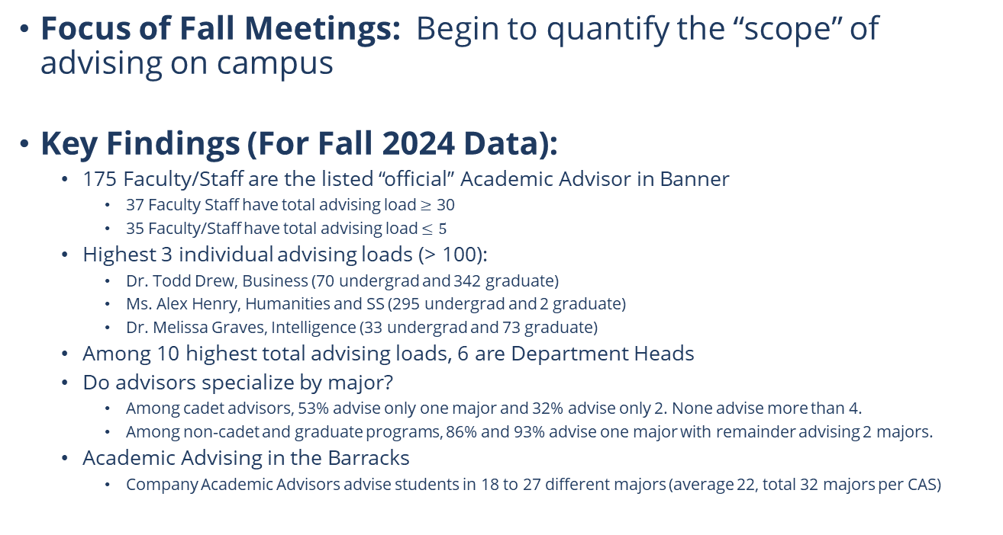
Advising Assessment – Fall Information
Focus of Fall Meetings: Begin to quantify the “scope” of advising on campus
Key Findings (For Fall 2024 Data):
  175 Faculty/Staff are the listed “official” Academic Advisor in Banner
    37 Faculty Staff have total advising load $≥$ 30
    35 Faculty/Staff have total advising load $≤5$
  Highest 3 individual advising loads (> 100):
    Dr. Todd Drew, Business (70 undergrad and 342 graduate)
    Ms. Alex Henry, Humanities and SS (295 undergrad and 2 graduate)
    Dr. Melissa Graves, Intelligence (33 undergrad and 73 graduate)
  Among 10 highest total advising loads, 6 are Department Heads
  Do advisors specialize by major?
    Among cadet advisors, 53% advise only one major and 32% advise only 2. None advise more than 4.
    Among non-cadet and graduate programs, 86% and 93% advise one major with remainder advising 2 majors.
  Academic Advising in the Barracks
    Company Academic Advisors advise students in 18 to 27 different majors (average 22, total 32 majors per CAS)

Slide 8
Advisement Training & Resources
Members: Emily Carver, M.Ed.; Kwangho Park, Ph.D.; Andrew Zutell, Ph.D.; John Egan, Ed.D.
Primary Goal: Create advising training modules in Canvas and provide additional advising resources on the advising website by May 2025
Next Steps: Focus group/s with successful faculty advisors on campus to explore the most critical advising resource and training needs

Slide 9
Progress Update – Advisement Training & Resources
Conducted two focus groups to identify training and resource gaps for faculty advising
Collected resources currently in use from faculty advisors
Met or communicated with key stakeholders to gather resources
Begun developing Canvas training course as outlined by the QEP

Slide 10
Training/Resource Gaps Identified from Focus Groups
  Lack of initial training (“on the fly” learning)
  “How-to” guides needed for commonly used tools (Degree Works, Banner, etc.)
  Need for accessible resource hub (policy, program maps, forms, critical deadlines)
  Complex advising situations and populations (ROTC, veteran students, student athletes, study abroad, General Education, etc.)
  Navigating multiple student resources/departments
  Documentation practices

Slide 11
Canvas Advisement Training Learning Objectives
Identify the essential functions of advising
Locate appropriate campus resources and points of contact based on student needs
Recognize the unique advising needs of specific student populations
Apply essential tools and resources to advising situations to meet diverse student needs

Slide 12
Advising Syllabus
Outline of feedback from faculty and students:
Provide more guidance on how to integrate the syllabus into faculty member’s advising practices.
Could use the same content in a different format. I fear students don’t even read their syllabus for their courses! Maybe it could take the form of an advising agreement signed by the students or it could be several slides that a faculty member could cover in-person with their advisee.
Length of the document.
Students are interested in “getting support as they create their own academic plan that highlights their skills and interests”
“On when and how to fill out various Registrar forms” (put some step-by-step procedures?).
Use visual representations over text-heavy narrative.
Advising Syllabus Working Group Plan for spring:
Review feedback & revise the advising syllabus to incorporate all feedback and ensure it supports the best practices in advising.

Slide 13
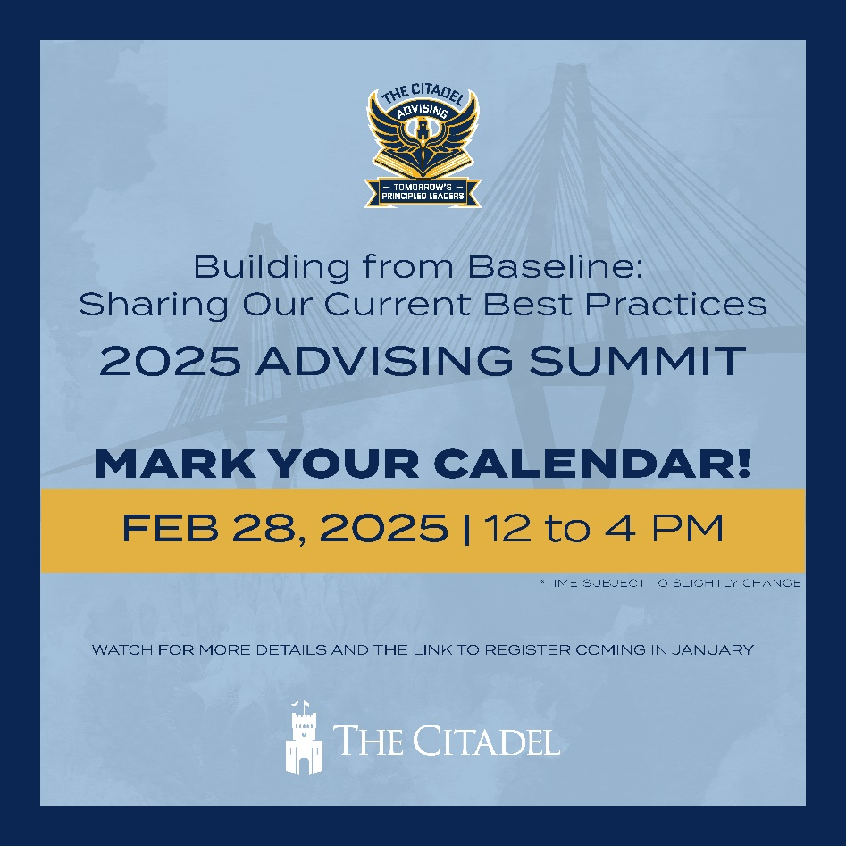
Advising Summit
Planning Team: LTC Stephanie Fye, Alex Henry M.A., Dr. Karin Roof, Ms. Tay Thompson, Dr. Timothy Wood
Date: Friday, February 28, 2025
Time: 11:30am – 4:00pm
Agenda:
  1130: arrival & check in
  1200: lunch & keynote speaker
  1300: student panel, break out presentations/workshops
  1600: conclusion of Summit & optional social networking hour
Please share with your teams, registration opens soon!

Slide 14

Student Health & Wellbeing Conference

Slide 15
Open Discussion
We welcome your questions & feedback!
https://www.citadel.edu/assessment/advising-tomorrows-principled-leaders/

